Slide 1
Treasury Management
Interest Risk Management

Slide 2
Outline
Introduction to Interest Rate Risk
Term Structure of Interest Rates
Interest Rate Theories
Interest Rate Swaps
Forward Rate Agreements
Interest Rate Futures
Interest Rate Options

Slide 3

Introduction
Interest rate risk is the potential variability in a firm’s profits and market value due to changes in the level of market interest rates
Interest rate risk arises because some of the firm’s assets and liabilities are sensitive to changes in market interest rates
A firm may obtain a loan from a financial institution and charged a fixed rate or floating rate basis

Slide 4
Introduction
A floating rate of interest is likely to bring interest rate risk as it is adjusted according to current market rates
Firms are likely to reduce their exposure to risk by firstly identifying the different elements of risk (i.e. interest rate, foreign exchange, political risk etc)
Secondly they have to quantify the risk (i.e. through portfolio theory and the capital asset pricing model)

Slide 5
Introduction
Interest rate risk deals with the possibility of loss arising from a change in the level of interest rates
One aspect of treasury function is management of debt in such a way as to reduce the company’s exposure to risk arising from interest rate movements

Slide 6

Term Structure of Interest Rates
The term structure of interest rates is the spread of interest rates that are paid on the same type of assets with different terms of maturity
One of the primary considerations in evaluating debt is the likely movement in interest rates
This will affect the relative costs of long and short term debt, as well as decreasing the preference for fixed interest rates

Slide 7
Term Structure of Interest Rates
In practice, long term rates will normally be higher than short term rates, owing to the additional risk borne by the lender.
The term structure of interest rates is often plotted on a yield curve

Slide 8
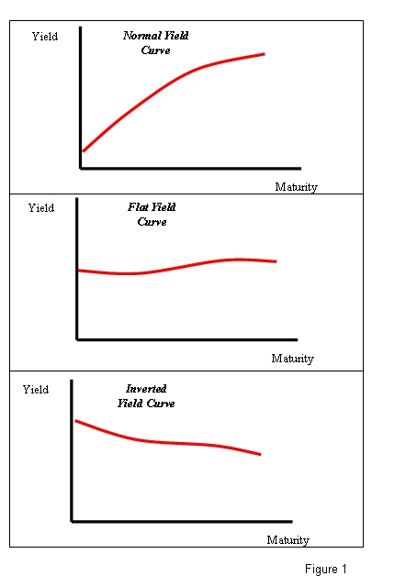
Yield Curves

Slide 9
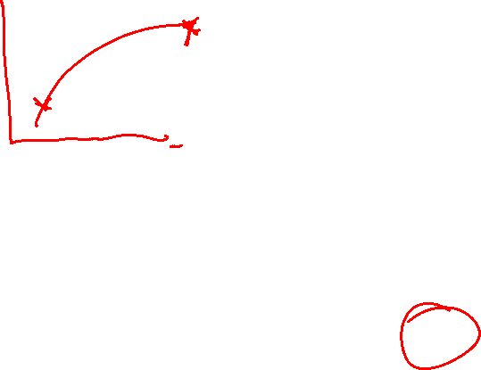
Yield Curves
A normal yield curve slopes upwards as borrowers who wish to borrow for long periods of time pay a higher rate of interest than short term borrowers
The characteristic upward curve is attributable to liquidity preference and to risk
The overall risks associated with lending increase over time, because other risks increase

Slide 10
Yield Curves
These risks are:
Default- either of interest or principal, which will generally increase with the length of the loan
Real capital loss- due to inflation, which increases with the length of the loan
Capital loss on marketable securities- which, if they have to be sold prior to maturity, increases with length of the loan

Slide 11
Yield Curves
iv. Changes in the lender’s circumstances- which, making a particular loan within a portfolio inappropriate to new circumstances will increase with the length of the loan

Slide 12
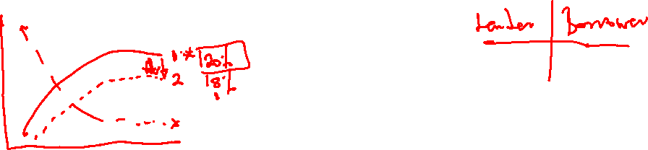
Yield Curves
Yield curves can be quite volatile over time
Positively sloped yield curves may become inverted yield curves, and yield curves can shift both upwards and downwards
If interest rates are expected to fall, long term interest rates will be depressed relative to short term rates.
Lenders will prefer to make longer term loans now at the higher rate

Slide 13
Yield Curves
On the other hand, borrowers wish to borrow short term in order to be able to rollover their loans
When a rise in interest rates is generally expected, the impact will be for long term rates to be increased relative to short-term rates
Borrowers here seek to borrow long term in order to lock in at the current low rates, will seek to avoid borrowing short term

Slide 14
Yield Curves
Lenders on the other hand will be unwilling to lend long term
Yield curves are influenced by interest rate changes

Slide 15
Interest Rate Theories
Expectations theory
Liquidity preference theory
Preferred habitat theory
Market Segmentation theory

Slide 16
Interest Rate Risk Management
The traditional ways of managing interest rate risk has been fixed-rate borrowing in the form of loans
However it is not always possible to obtain fixed rate loan or for the amounts required
A number of financial instruments exist which allow the treasurer to hedge interest rate risk

Slide 17
Interest Rate Swaps
An interest rate swap is an agreement involving two parties to exchange periodic interest rate payments
The value of the interest rate payments to be exchanged is based upon a specified amount of principal i.e. notional principal amount
One party agrees to pay the other party a fixed interest rate payment at specified dates,

Slide 18
Interest Rate Swaps
While the other party agrees to pay a floating rate of interest based upon a reference rate of interest e.g. LIBOR, TB rates or CD rates
The party paying the fixed rate of interest is known as the fixed rate payer
The party making the floating payments is referred to as the floating rate payer.

Slide 19
Swap Example
Zambia Sugar has a high credit rating
It can borrow at a fixed rate of 10% or at a variable interest rate of LIBOR+0.3%
It would like to borrow at a variable rate
Lafarge Cement Plc. has a lower credit rating
It can borrow at a fixed rate of 11% or at a variable rate of LIBOR +0.5%

Slide 20
Swap Example
It would like to borrow at a fixed rate
Using the principle of comparative advantage, both parties could benefit from a swap arrangement, whereby:
Zambia Sugar PLC borrows at a fixed rate of 10%
Larfarge Cement PLc borrows at a variable rate of LIBOR+0.5%

Slide 21
Swap Example
The parties agree a rate for swapping their interest commitments with perhaps;
Lafarge Cement Plc paying a fixed rate of 10.1% to Zambia Sugar PLc and Zambia Sugar Plc paying a variable rate of LIBOR to Lafarge Cement Plc

Slide 22
Swap Example
 | Fixed Rate | Floating Rate | Advantage
Zambia Sugar Plc | 10% | Libor+0.3% | Absolute
Lafarge Cement Plc | 11% | Libor + 0.5% | Comparative
Difference | 1% | 0.2%

Slide 23
Swap Example
The outcome would be:
Zambia Sugar Plc
Borrows at fixed 10%
Receives from Lafarge Plc (10.1%)
Pays Lafarge PLC LIBOR
LIBOR -0.1%
A saving of 0.4%

Slide 24
Swap Example
Lafarge PLc
Borrows at LIBOR+0.5%
Receives from Zambia Sugar (LIBOR)
Pays to Zambia Sugar Plc 10.1%
Net interest cost 10.6%
(a saving of 0.4%)

Slide 25
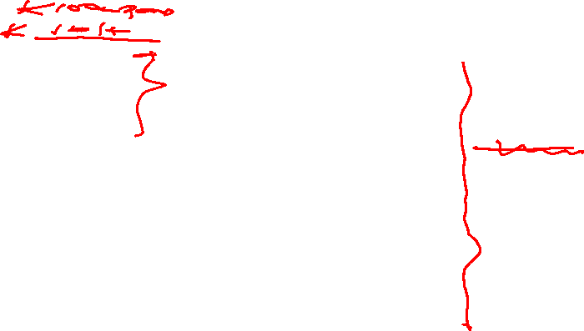
Swap Example

Slide 26
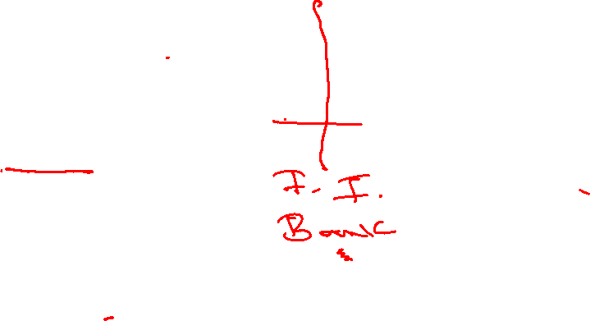
Swap Example

Slide 27
Forward Rate Agreements
A forward rate agreement (FRA) is an agreement whereby a firm can lock in an interest rate today for a period of time starting in the future
On the future date, the two counterparties in the FRA settle up
Depending on which way rates go, one will pay an amount of money to the other, representing the difference between the FRA rate and the actual rate

Slide 28
FRA Example
XYZ Plc has a ZMW1,000,000 loan outstanding on which the interest rate is reset every six months for the following six month period
The treasurer of XYX Plc thinks that interest rates are likely to rise
Current six-month rates are 8% and the treasurer can get a rate of 8.1% for a six month FRA starting in three months time

Slide 29
FRA Example
By transacting an FRA, the treasurer can lock in a rate today at 8.1%
If interest rates as expected rise to say 9%, XYZ Plc has reduced its interest rate charge as it will pay the current 9% rate on its loan but will receive from the FRA counterparty the difference between 9% and 8.1%
However, if rates drop to 7%, XYX Plc will still end up paying an effective rate of 8.1% as it will pay the FRA counterparty the difference between 7% and 8.1%

Slide 30
FRA Example
If rates are 9% in three months time:
Interest payable on loan @9% x K1m x 6/12= K45,000
Amount receivable from FRA (9%-8.1%) = (K4,500)
Net amount = K40,500
The K40,500 is the net amount payable, giving an effective rate of 8.1%

Slide 31
FRA Example
If rates are 7% in three months time:
Interest payable on loan 7% x K1mx 6/12 = K35,000
Amount payable on FRA (8.1%-7%) = K5,500
Net amount = K40,500
The K40,500 is the net amount payable, again giving an effective rate of 8.1%

Slide 32
Interest Rate Futures
An Interest rate future is a commitment to borrow or lend a predetermined sum of money at a specified future date at a predetermined rate of interest
Futures are standardised traded forms of FRAs
FRAs are normally transacted with banks and other financial institutions and are tailor made to suit the dates and amounts that each individual company requires
Interest rate futures are exchange traded and each contract is for a pre-specified amount and date

Slide 33
Interest Rate Futures
If a company does not need specific amount or set dates, then futures are useful
However most companies would find the margin payments payable on futures contracts burdensome
Futures contracts are very liquid and can be sold on the futures
In the FRA example, the treasurer could not have sold on the reverse effect of the first

Slide 34
Interest Rate Futures
With a future, it is a very easy matter just to sell the future back.
The pricing of interest futures is based on taking the interest rate away from 100
If the interest rate was 7%, then the futures price would be 100-7 i.e. 93
If the interest rate were 12%, the futures price would be 100-12 i.e. 88

Slide 35
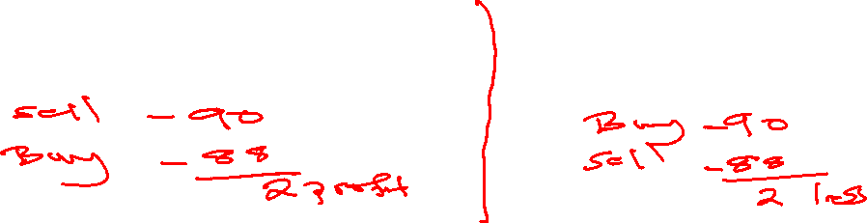
Interest Rate Futures
A borrower of funds who wishes to protect themselves against a rise in interest rates should sell the interest rate contract
If interest rates rise they will gain as the contract falls in price
A lender of funds who wishes to protect themselves against a fall in interest rates should buy the interest rate contract

Slide 36
Interest Rate Futures
If interest rates fall they will gain as the contract rises in price

Slide 37
Hedging Using Interest Rate Futures
Assume that it is June and a company currently has a loan of K1,000,000 at a variable interest rate
Interest on the loan is currently 3 per cent subject to review in 3 months time in September
The company wishes to protect itself against a rise in interest rates

Slide 38
Hedging Using Interest Rate Futures
The firm can sell interest rate futures contract with a face value of K1,000,000
Assume the price of the contract is currently 97 i.e. 3 per cent
Each basis point i.e. 0.01 movement in the price of the contract is worth ¼ x 0.01 x K1,000,000 = K25
What would happen if interest rate rose to 4% in September?

Slide 39
Hedging Using Interest Rate Futures
The firm would pay an extra 1 percent on its borrowing costs i.e. 1 x ¼ x 1,000,000 = K2,500 per quarter
However in September the firm will close its position by buying back the September futures contract for 96
This is the price of the futures contract as interest rates have risen to 4 per cent

Slide 40
Hedging Using Interest Rate Futures
This leaves the company with a profit on its futures contract of 1.00 x ¼ x K1,000,000 = K2,500
The company has been able to offset its higher borrowing costs with the gain from closing out its short position on the September futures contract

Slide 41
Speculating Using an Interest Futures
It is September and a speculator observes that the December Interest rate futures contract is at 98 i.e. 2 per cent
The speculator feels that by December the three month interest rates will be 3 per cent.
the speculator can sell a December futures contract today at 98

Slide 42
Speculating Using an Interest Futures
If he correct, and in December the three month interest rate is 3 per cent, then the futures contract will be valued at 97
Each basis point movement in the contract is worth:
0.01 x 0.25 x K1,000,000 = K25
The contract can be closed out at 97 i.e. a profit of 100 basis points or 100 x K25 =n K2,500 per contract sold

Slide 43
Interest Rate Options
An option is a right but not the obligation, to carry out a transaction at a price set today, at some time in the future.
Swaps, FRAs and futures are all contracts which two parties agree to transact and which must be carried out even if circumstances change
An option, however, gives the buyer the choice of whether to transact or not

Slide 44
Interest Rate Options
A company would generally buy an option from an option seller or option writer
An option is a form of insurance, and such, a premium is paid at the time the option is taken out, for the period of the option

Slide 45
Interest Rate Option Example
In the FRA example, XYZ Plc paid a net amount of K40,500 no matter what happened to interest rates
Suppose XYZ had purchased an option, entitling the buyer of the option to pay the same interest rate of 8.1%
This is known as the strike price
The period of the option is for three months, which is when the renewal period for the loan starts
Suppose that the option premium paid is K1,000

Slide 46
Interest Rate Option Example
If rates are 9% in three months time:
Interest payable @9% x K1m x 6/12 K45,000
Exercise the option at a strike price of 8.1% (K4,500)
Plus premium paid 1,000
Net Amount K41,500

Slide 47
Interest Rate Option Example
If rates are 7% in three months time:
Interest payable on the loan 7% x K1m x 6/12 K35,000
Plus premium paid 1,000
Net amount K36,000

Slide 48
Interest Rate Options
If interest rates are 9% in three months time, XYZ Plc will pay a net amount of K41,500 in interest over the six month period, which is more than the FRA because of the option premium
However, if the rates fall to 7% it will only pay K36,000, as the company does not need to exercise the option

Slide 49
Interest Rate Option Example
An option is therefore not quite so favourable when rates go as expected, but much better when rates move in the opposite direction
With an option, a company can take advantage of favourable interest rate movements
Interest rate options can be purchased from banks, while standardised interest rate options are traded on LIFFE

Slide 50
Caps, floors and Collars
An interest rate cap is an option which sets a maximum interest rate on future borrowings for an agreed length of time
A floor is an option that sets a minimum interest rate
A collar arises when a borrower buys an interest rate cap and at the same time sells an interest rate floor
The premium received from selling the floor will reduce the cost of the premium paid for the cap

Slide 51
Cap, Floor, Collar Example
Zambian Breweries Plc can currently borrow at 11%, but is concerned that interest rates may rise in the near future to 14% or more.
In this situation, the company could buy an interest rate cap from a bank which will fix the maximum rate for borrowing
The bank will reimburse the company if market interest rates rise above the cap rate

Slide 52
Cap, Floor, Collar Example
As part of the arrangement, the company may also agree that it will pay a floor rate of say, 10%
The bank will pay a premium to the company for agreeing to this floor rate.

Slide 53


